Slide 1
Chapter 3 Fundamentals of the Unified Modeling LanguageTM (UML®)
3.1 Introduction
3.2 Use Case Modeling
3.3 Structure Modeling
3.4 Behavior Modeling
3.5 Implementation Modeling
3.6 Extensibility Mechanisms
3.7 CRC Cards
3.8 Object Constraint Language (OCL)
Exercises

Slide 2
3.1.6 Different Perspectives of a System
系統要做甚麼用?
Functional Model
Use Case Diagrams
由哪些元件組成?
Structure Model
Class/Object Diagrams
Activity Diagrams
Sequence Diagrams
Collaboration Diagrams
Statechart Diagrams
A System
Behavior Model
流程怎麼運作?
Implementation
Model
Component Diagrams
Deployment Diagrams
怎麼安裝?
is viewed by
is represented by
Notes:
Notes
Since a system is described by models, a system can be view by various models, such as functional model, structure model, behavior model and implementation model; these models could be represented by the UML’s nine diagrams.

Slide 3
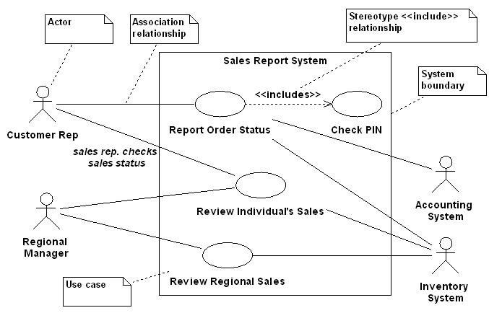
Use Case Diagrams
Example: A Sales Report System

Slide 4
3.2.5 Use Case Documents
There is no standard use case document format ^{(*)}.
Use Case Document typically includes
Use case name
Participating actors
A brief description
Preconditions
Primary flow of events
Alternative flow of events
Postconditions
Special requirements
(*) You may refer to [Schneider 2001] Supplement B: Documentation Templates.

Slide 5
In Class Exercise
請撰寫”線上論壇”的use cases
所有使用者皆可瀏覽與閱讀文章
已登入的使用者可以發表文章
文章作者跟站長可以刪除文章
請評估是否有地方適合使用 <<extend>> or <<include>>
請針對各個use case撰寫use case documents

Slide 6
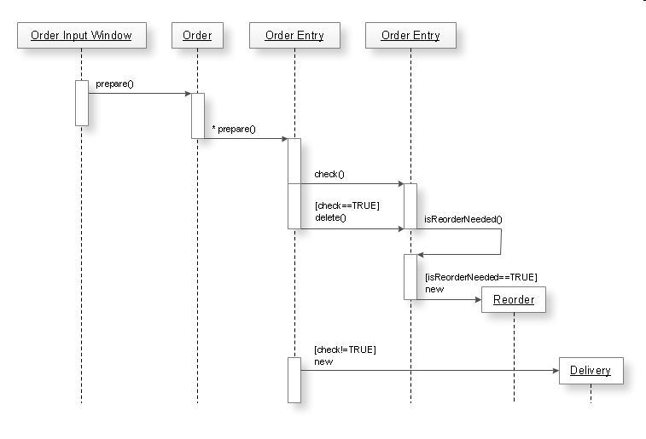
Sequence Diagram
Example: a sequence of processing an order

Slide 7
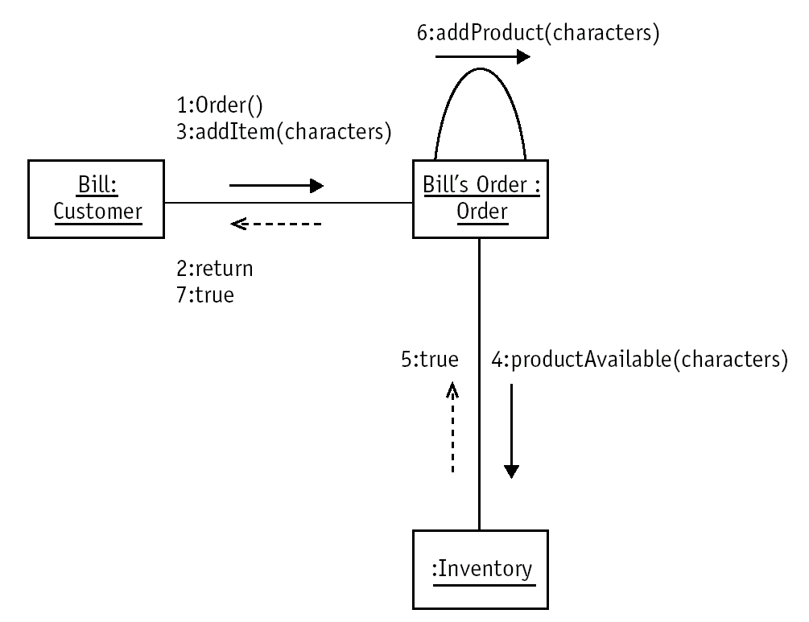
Collaboration Diagram
Example: Customer Bill making orders

Slide 8
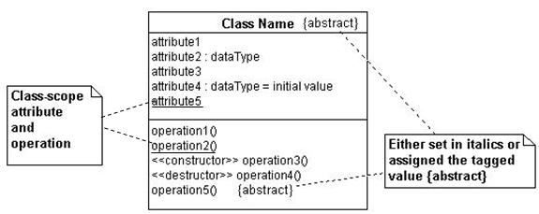
Basic UML Notation of Classes
The following shows the basic UML notation of a class in which class-scope attribute and operation, which are shared between all objects of the same class, should be underlined.

Slide 9
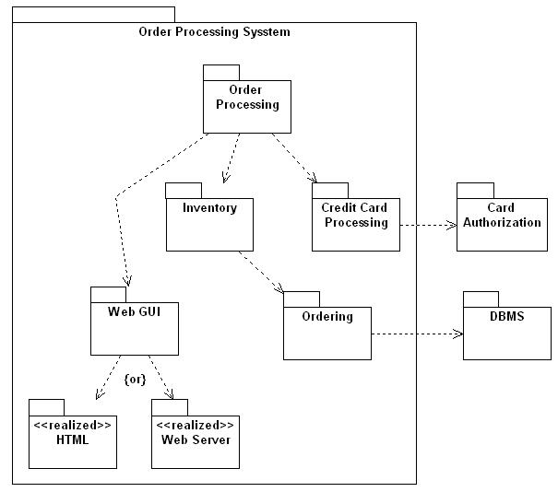
Packages (cont’d)
Example: A domain chart of the Order Processing System.

Slide 10
3.4 Behavior Modeling
3.4.1 An Introduction to Behavior Modeling
3.4.2 Sequence Diagrams
3.4.3 Collaboration Diagrams
3.4.4 Statechart Diagrams
3.4.5 Activity Diagrams

Slide 11
3.4.1 An Introduction to Behavior Modeling
All systems have a static structure (documented by class diagrams) and dynamic behavior (documented by dynamic diagrams).
Dynamic behavior is described by:
Sequence Diagrams: describe how objects interact and communicate with each other, focusing on time sequence;
Collaboration Diagrams: describe how objects interact, focusing on space;
Statechart Diagrams: describe which states an object can have during its life cycle, and the behavior in those states; and
Activity Diagrams: show objects that perform work in terms of activities.

Slide 12
Introduction to Behavior Modeling (cont’d)
An interaction between two objects is performed as a message sent from one object to another with the following message broadcast types:
Simple: a single flow of execution, in which only a single object is active at a time. The transfer of control is performed from one object to another without describing any details about the communication.
Synchronous: once the message is sent, the sender is blocked until the receiver accepts the message.

Slide 13
Introduction to Behavior Modeling (cont’d)
Asynchronous: the sender sends the message without knowing when or even if the receiver will process the message.
Time out: a timed message blocks the sender for a given period of time while waiting for acknowledgement by the receiver. The sender is freed up if the acknowledgement does not occur.
Balking (rendezvous): in case of balking message, the receiver agrees to wait, whereas in case of synchronous message, the sender agrees to wait.

Slide 14
Introduction to Behavior Modeling (cont’d)
Interaction Diagrams are used when modeling the dynamic aspects of a system. There are two way to use interaction diagrams [Booch et al. 1999]:
To model flows of control by time ordering
Sequence diagrams are used
To model flows of control by organization
Collaboration diagrams are used.
Summary: Interaction diagrams commonly contain
Objects, Links, Messages

Slide 15
3.4.2 Sequence Diagrams
A Sequence Diagram shows the chronological order of objects interactions.
The objects (not classes) and the messages that pass between them when an interaction occur.
Messages show one object interacting with another.
Two specific features of a sequence diagram:
Object lifeline: represents the existence of an object over a period of time, that is, objects may be created or destroyed during the interaction.
Focus of control: shows which object is currently active, that is, the activations of the objects.
Using sequence diagrams
To map functionality stipulated by use cases into classes
To help determine what classes to reuse, enhance

Slide 16
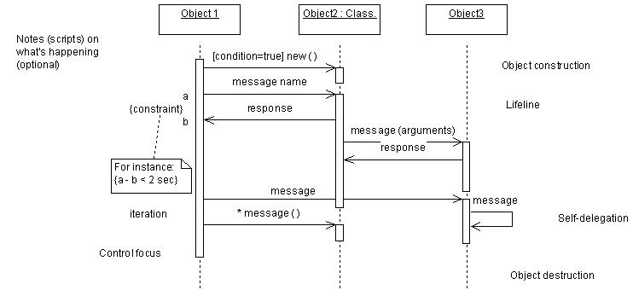
Sequence Diagrams (cont’d)
Notations to create a sequence diagram.
Time sequence
Notes:
Notes

Slide 17
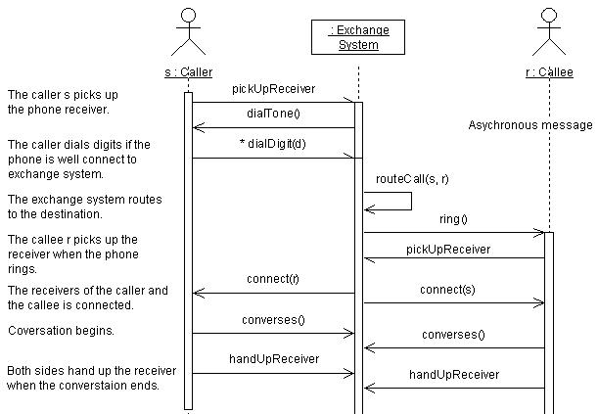
Sequence Diagrams (cont’d)
Example: A simple sequence diagram of Phone Call.

Slide 18
3.4.3 Collaboration Diagrams
A Collaboration Diagram shows a set of interactions between the objects that participate in the interactions, focusing on the structural organization of the objects that send and receive messages.
Collaboration diagrams are used when the software developers are less concerned with the time ordering of interactions and more concerned with the interacting objects themselves.
Basically, collaboration diagrams and sequence diagrams are semantically equivalent.

Slide 19
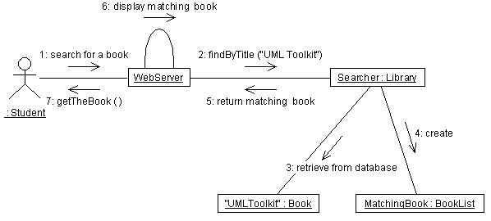
Collaboration Diagrams (cont’d)
Example: Suppose a student wants to search a book called “UML Toolkit” in the university library, it may be shown as the following collaboration diagram which emphasizes the instances and de-emphasize the chronological ordering.

Slide 20
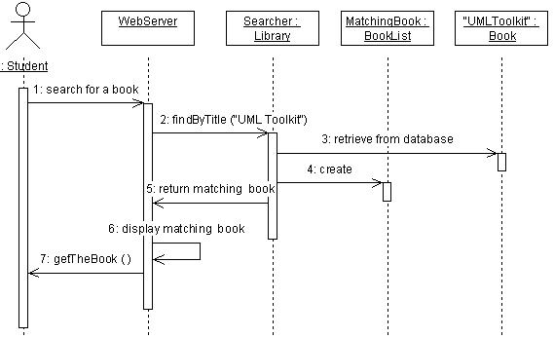
Collaboration Diagrams (cont’d)
The example in the previous slide may be shown in a sequence diagram if a chronological ordering is emphasized.
Note: Students who are more interested in collaboration and sequence diagrams may refer to [Booch et al.. 1999].

Slide 21
3.4.4 Statechart Diagrams
A Statechart Diagram shows a structured finite state machine that expresses an object lifecycle, that comprises:
State: represents a situation during the life of an object;
Event: represents an incident or indications that progression is happening;
Transition: specifies what new state is achieved under transition rule when an object receives a particular event;
Action: an executable atomic computation that results in a transition from one state and another, and cannot be interrupted.
Statecharts [Harel et al. 1998] are hierarchical state machines that support the concepts of orthogonality, aggregation (and/ concurrent substate) and generalization (or/xor substate).

Slide 22
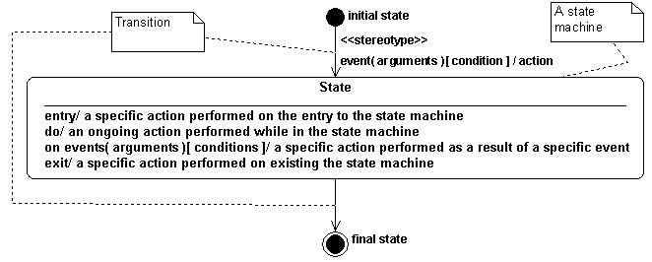
Statechart Diagrams (cont’d)
A State Machine specifies the sequences of states during the lifetime of an object in response to events, together with its response to those events.
A state machine: state, transition, initial state, final state

Slide 23
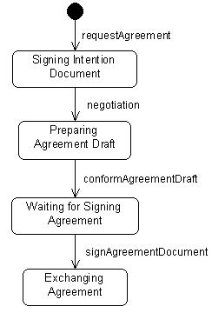
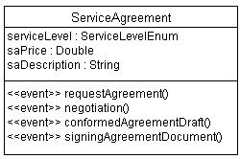
Statechart Diagrams (cont’d)
One state machine for each class (a class may be seen as a state machine). For example:

Slide 24
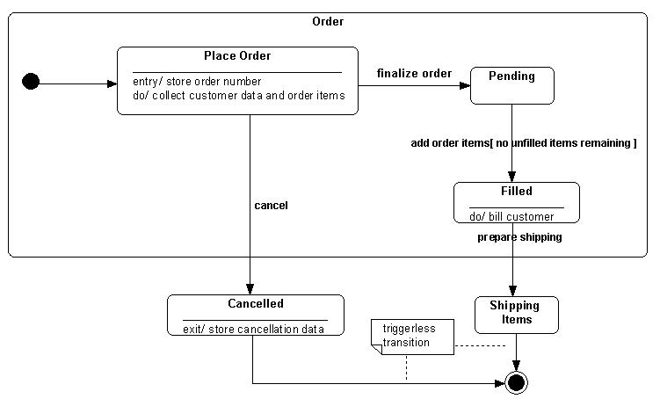
Statechart Diagrams (cont’d)
Example: Order class

Slide 25
Example
Black wins
White’s move
start
stalemate
black
moves
white
moves
Draw
stalemate
Black’s move
White wins

Slide 26
3.4.5 Activity Diagrams
An Activity is an ongoing non-atomic execution within a state machine.
An activity is interruptible.
An Activity Diagram “shows the flow from activity to activity, addressing the dynamic view of a system.” [Booch et al. 1999]
An activity diagram is “a special case of a state machine that used to model processes involving one or more classifiers ^{(*)}.” [OMG-UML v1.4]
An activity diagram is used to model the flow of activities in a procedure.
(*) A model elements that describes behavior and structural features, e.g., class, use case, interface, etc.

Slide 27
Activity Diagrams (cont’d)
An activity diagram consists of:
activity,
transition,
decision,
synchronization,
swimlanes,
initial state,
and final state.

Slide 28
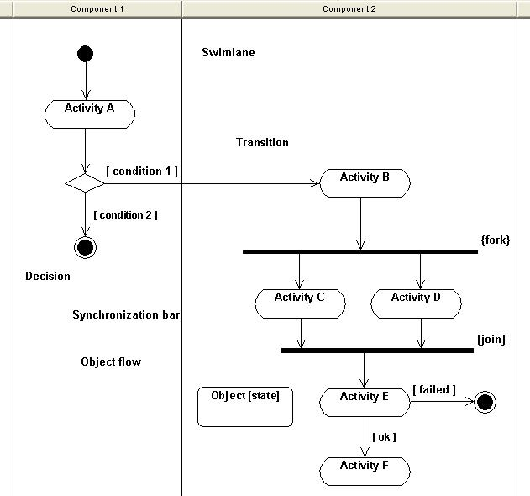
Activity Diagrams (cont’d)
Initial
state
Activity diagram notations
Final
state

Slide 29
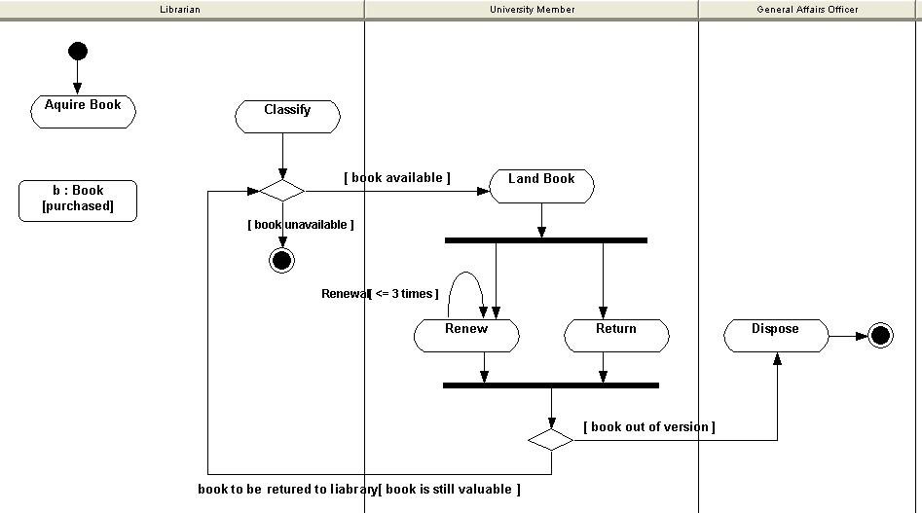
Activity Diagrams (cont’d)
Example: The life of a copy of book.

Slide 30
Activity Diagrams (cont’d)
Activities and activity diagrams are associated either to:
a business process,
a class (a component),
an operation,
a use case (to describe the scenarios of a use case),
that is, you can use activity diagrams to describe these elements.

Slide 31
3.5 Implementation Modeling
3.5.1 Component Diagrams
3.5.2 Deployment Diagrams

Slide 32
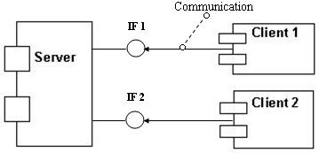
3.5.1 Component Diagrams
A Component Diagram shows the interrelations between components that represent physical piece of program code, such as source code, executables, DDL etc.
Notations.

Slide 33
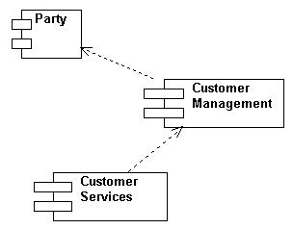
Component Diagrams (cont’d)
Dependency relationships between components indicate that a component refers to services offered by other components.
Example: A simplified Customer Relationship Management (CRM)

Slide 34
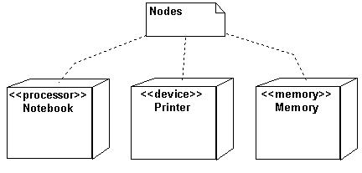
3.5.2 Deployment Diagrams
A Deployment Diagram describes the physical architecture of the hardware components (nodes) and software components that reside at run-time.
Representation of nodes.

Slide 35
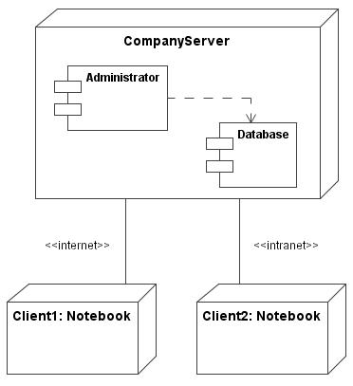
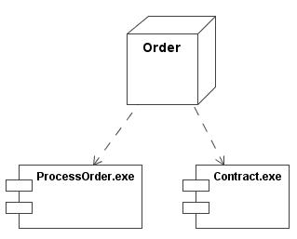
Deployment Diagrams (cont’d)
Examples:
Nodes and components.
Connections.

Slide 36
3.6 Extensibility Mechanisms
3.6.1 Constraints
3.6.2 Tagged Values
3.6.3 Stereotypes

Slide 37
3.6.1 Constraints
A Constraint extends the semantic of a UML element, allowing you to add new rules or modify existing ones. [Booch et al. 1999].
A constraint can limit the value that an attribute can take, or it can limit the value that an operation can accept.
The constraints may be expressed by the Object Constraint Language (OCL) or by free-form text.
Specified within brackets: { constraint …. }

Slide 38
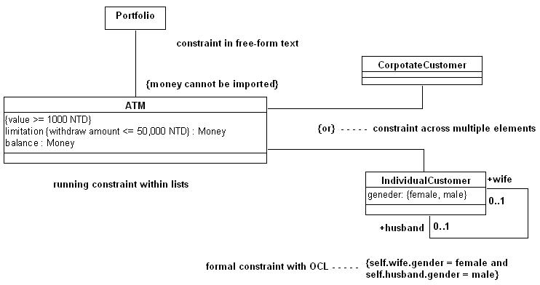
Constraints (cont’d)
Example:

Slide 39
Constraints as a tagged Boolean assertion
This constraints is represented as a togged Boolean assertions attached to a model element.
they are attached to one or more model element
this shows a note containing a class constraint

Slide 40
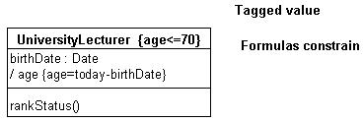
3.6.2 Tagged Values
A Tagged value extends the semantics of a UML element, allowing you to create new information in that element’s specification.
A tagged value is expressed by strings. Each tagged value is shown in the form: tag name = value. If the value is Boolean which is true, the value may be omitted.
Example:

Slide 41
3.6.3 Stereotypes
A Stereotype represents a variation of an pre-existing metamodel element with the same form but with a different semantic.
A stereotype allows you to create new kinds of elements that are derived from existing one for the specific purpose.
Stereotypes can be applied to class, component, dependency, generalization, operations, packages.
There are standard elements of stereotypes in the UML [Rumbaugh et al. 1999]. However, users are allowed to define their user-defined stereotypes for special purposes.
Specified within << >>: << stereotype name >>, or by any icons

Slide 42
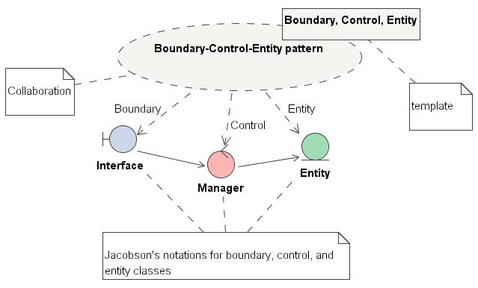
Stereotypes (cont’d)
Example: The basic “boundary-control-entity” pattern [Jacobson et al.. 1997] – this pattern is a kind of Model-View-Control (MVC) ^{(*)} pattern.
Most of the classes can be categorized to one of the classes: boundary, control or entity class (we call these classes the ideal model classes) ^{(**)}.
(*) See “Pattern-Oriented Software Development”. (**) Ivar Jacobson’s “Ideal Object Model”.

Slide 43
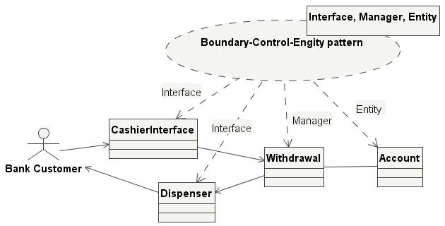
Stereotypes (cont’d)
Example: Application to the Boundary-Control-Entity pattern – Cash Withdrawal use case realization.

Slide 44
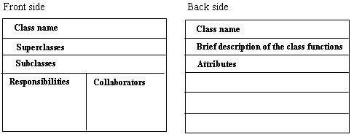
3.7 CRC Cards
A Class-Responsibilities-Collaborator (CRC) ^{(*)} cards identify and define the characteristics of the classes that make up an application in an informal way.
The layout of a CRC card (a 3-in x 5-in card).
Invented by Ward Cunningham and Kent Beck in 1989.

Slide 45
CRC Cards (cont’d)
Example: The Whole-Part relationship [Buchmann et al.. 1996].
Class Whole
Class Part
Responsibilities
Aggregates several
smaller objects.
Provides services
built on top of part
objects.
Acts as a wrapper
around its
constituent parts.
Collaborators
Part
Responsibilities
Represents a
particular object and
its services.
Collaborators
Whole

Slide 46
3.8 Object Constraint Language (OCL)
3.8.1 Introduction
3.8.2 Some OCL Elements
3.8.3 Building OCL Models with OCL
3.8.4 Examples

Slide 47
3.8.1 Introduction
Object Constraint Language (OCL)^{(*)} is a formal language which allows additional semantics to be added to UML models, which are not refined enough to provide all the relevant aspect of a specification.
Using OCL you can specify constraints and queries in side effect-free and unambiguous manner.
Using OCL to specify the model new semantics more precisely and formally.
OCL is not for writing actions or executable code.
Expressions written in OCL add vital information for object-oriented models and other object modeling artifacts [Warmer et al. 2003].
(*) You may refer to the UML 2.0 OCL RfP, revision 1.6, OMG document ad2003-01-8.

Slide 48
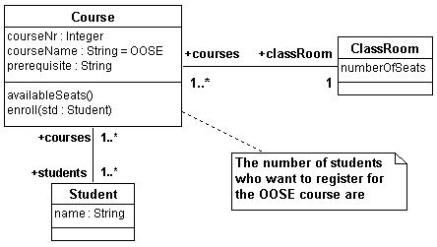
Introduction (cont’d)
Why we need OCL – an example
The class diagram cannot express a thorough specification.
Multiplicity many (1..*) on the side of the Student class indicates the number of students are unlimited. This is not the reality. The correct way to specify the multiplicity is to add the following OCL constraint as
context Course
inv: students -＞size ( ) ≦ classRoom.numberOfSeats

Slide 49
3.8.2 Some OCL Elements
Some commonly used OCL operations
size: passengers －＞size ( ) ＜＝ aircraft.numberOfSeat
select: company.employee －＞select (title = “Manager” and
self.reports －＞size ＞10)
forAll: self.voter －＞forAll (v∣v.age ＞= 20) or
self.voter －＞ forAll (age ＞= 20)
collect: self.parents －＞collect(brother) －＞collect(children) －＞
notEmty
operators: the usual arithmetic and Boolean operators: “=“, “<“, “>”,
“＜＝”, “＞=“, “＜＞”, “＋”, “－”, “∗” , “/”, “not”
Note: the notation “－＞” is a Set operation followed by the name of the property .

Slide 50
Some OCL Elements (cont’d)
Predefined basic types
Boolean: true, false
Integer: 1, 2, 3, 123, 543
Real: 3.1416, 0.22854
String: ‘To be or not to be – William Shakespeare’
Set: {12, 23, 34}, {‘red’, ‘blue’, ‘yellow’}
Bag: {12, 8, 8} //a set with possible repeated elements
Sequence: {1..10}, {8, 17, 25, 26, 30, 42} //an ordered bag
Note that Set, Bag, and Sequence are subclass of Collection.

Slide 51
3.8.3 Building OCL Models with OCL
A UML model can be augmented by OCL expressions.
Using context key word to define OCL expression
context c : OOSEClass
inv: numberOfStudents <= 50
UML class diagrams as a base
Initial values
context ClassRoom :: numberOfSeats : Integer
init: 50
Query operations
context ServiceAgreement :: getCustomerName ( ) : String
body: partners.programs.customers.name

Slide 52
Building OCL Models with OCL (cont’d)
Invariants
context Course :: availableSeasts ( ) : Integer
inv: classRoom.numberOfSeats – students －＞ size ( )
Preconditions and Postconditions
context Course :: enroll (std : Student)
pre: std.name <> ‘ ‘ and prerequisite = ‘Software Engineering’
post: students = students@pre －＞ including (std)
Cycles in class models (see the next slide)
context Person
inv: forAll (owner: Person | self.monthlyPayment.security.owner︱owner = self)

Slide 53
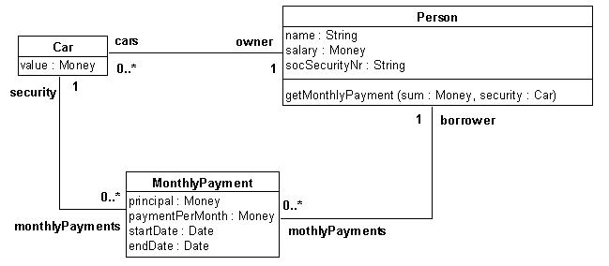
3.8.4 Examples
Example 1: A Monthly Payment System” for a car, expressed in a class diagram as:

Slide 54
Examples (cont’d)
Some OCL expressions for Monthly Payment System.
context MonthlyPayment
inv: security.owner = borrower
context MonthlyPayment
inv: startDate ＜ endDate
context Person
inv: Person::allInstances() －＞ isUnique(socSecurityNr)
context Person::getMonthlyPayment (sum:Money, security:Car)
pre: security.value ≧ security.monthlyPayments.pricipal －＞ sum ( )
context Person::getMonthlyPayment (sum:Money, security:Car)
pre: self.monthlyPayment －＞ sum ( ) ≦ self.salary * 0.2

Slide 55
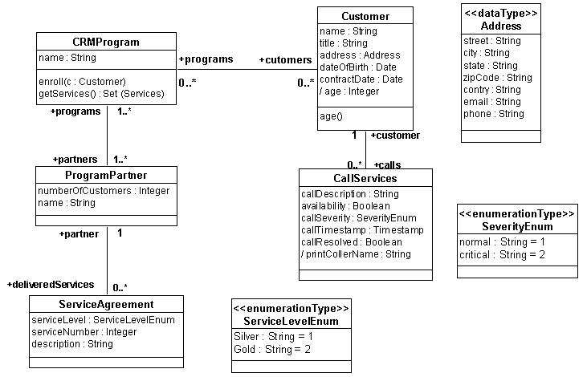
Examples (cont’d)
Example 2: A Customer Relationship Management

Slide 56
Examples (cont’d)
context CallServices::availability --initial value
init: true
context CallServices::printeCallName --initial value
def: customer.title.concat (‘ ‘).concate (customer.name)
context Customer --invariant on attribute
inv: Age: customer.age >= 18
context CRMProgram::getServices( ): Set (Service) --query operation
body: partners.deliveredServices －＞ asSet ( )
context CRMProgram::getServices(pp: ProgramPartner): Set(Service) --query op.
body if partners －＞ includes(pp)
then pp.deliveredServices
else Set( )
endif

Slide 57
Examples (cont’d)
context PrgramPartner::getCustomerNaem( ): String --query operation
body programs.customers.name
context Customer::birthdayHappen( ) --previous value (@pre) in postcondition
post: age = age@pre + 1
context CRMProgram::enroll(c:Customer) --OCL augments a UML model
pre: c.name <> ‘ ‘
post: customers = coustomers@pre －＞ include (c)
Note: The OCL expressions mentioned above are only some examples. As an exercise, readers may define more OCL expressions themselves, in order to understand that a UML model can be augmented by OCL expressions. Readers may refer to the “Object Constraint Language Specification” by OMG (http://www.omg.org).

Slide 58
Exercises
Why actors cannot directly interact with each other?
Connection between use cases is mistake. Why?
Actors in a small public library are: Borrower, Checkout Clerk, Librarian, and Accounting System. Draw an use case diagram for the library system.

Slide 59
Exercises (cont’d)
In exercise 5, checkout clerk performs the use case ‘Checkout a copy of book for a borrower’. Describe this use case in detail by a scenario.
What are the reasons to build use cases?
Can a use case be used to comprehend executable systems through reverse engineering?
Does the UML allow a tight or loose coupling to a variety of program languages such as Java?
What kind of view of the system being build a class diagram addresses?
A student may play an attendance role as a full time or part time student. In the other hand, a student may also play a level role as a graduate or under graduate student. Draw a class diagram in the UML to show these statements (adapted from [Lethbridge et al. 2001]).

Slide 60
Exercises (cont’d)
What is the purpose of a Sequence Diagram?
What are the different characteristics of superclasses (abstract classes) and subclasses (concrete classes) in the generalization mechanism?
Why you need the extensibility mechanism stereotype?
Is it desirable to have packages that are loosely coupled and tightly cohesive, just like a good set of classes? Why?
What is an interface?
What is a state machine?
What is the difference between an is-a relationship and has-a relationship?

Slide 61
Exercises (cont’d)
What is the difference between a sequence diagram and a collaboration diagram?
It is more appropriate to talk about “sending a message” than “invoking an operation” when objects communicate with each other. Why?
Discuss the advantages of using UML to “write” a model.
Why do you need OCL? Give an example.
A model is a simplification of reality. Unfortunately, there are many flaws in the model because of the limitations of the diagram being used. The specification cannot thoroughly be expressed by a diagram. The following class diagram shows the course of Object-Oriented Software Engineering (OOSE) offered by the Department of Information Engineering at a university.

Slide 62
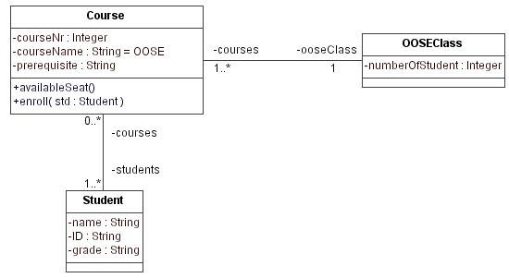
Exercises (cont’d)
Suppose the Department prescribes that the number of students who are registered to take the OOSE course should be limited in 75 students. In the UML model shown above, the multiplicity many (1..*) on the side Student class indicates the number student to be enrolled in the OOSE course is unlimited. This is not the requirement. How can you express the limitation in the OCL?

Slide 63
Exercises (cont’d)
The following statements are the flow of events of the Order business process. Draw an activity diagram to show the scenario of the process.
The order process begins when the order initiator creates a new order.
The order is opened for processing when an open event is authorized.
The order is sent to the vendor.
If the vendor declines the order, then the order initiator must withdraw.
If the vendor proposes amendments, then the order initiator may agree amendment with vendor; otherwise process order continually.
If no agreement can be reached, then the order initiator will withdraw order; otherwise the order initiator will amend the order.
If the order initiator withdraws the order, he/she appends a cancel event to the order. The process terminates.

Slide 64
Exercises (cont’d)
During processing the order the order initiator may cancel the order, the process terminates.
If the order is not cancelled, then at some point the order initiator will close the order (e.g., it has been paid for and delivered) by performing the activity of closing order.
The order process terminates.
Write a class model according to the following statement:
“An university consists of many university members, offering many courses. Lecturer and student are university member (they inherit from university member as subclass). The Minister of Education regulates the university such that the ratio of lectures and students should make up no more than 20:1. which is stated in a constraint at the top of the class diagram. A course contains many students, and each student is constrained to take from one to four courses.”

